Slide 1
Object-Oriented Programming
Programming Project #2

Slide 2
Data Center
A data center consists of multiple severs
The servers are connected by switches in a local area network
destination
source

Slide 3
Switches
Each switch has multiple ports
Receive and forward the packets from a port to another port

Slide 4
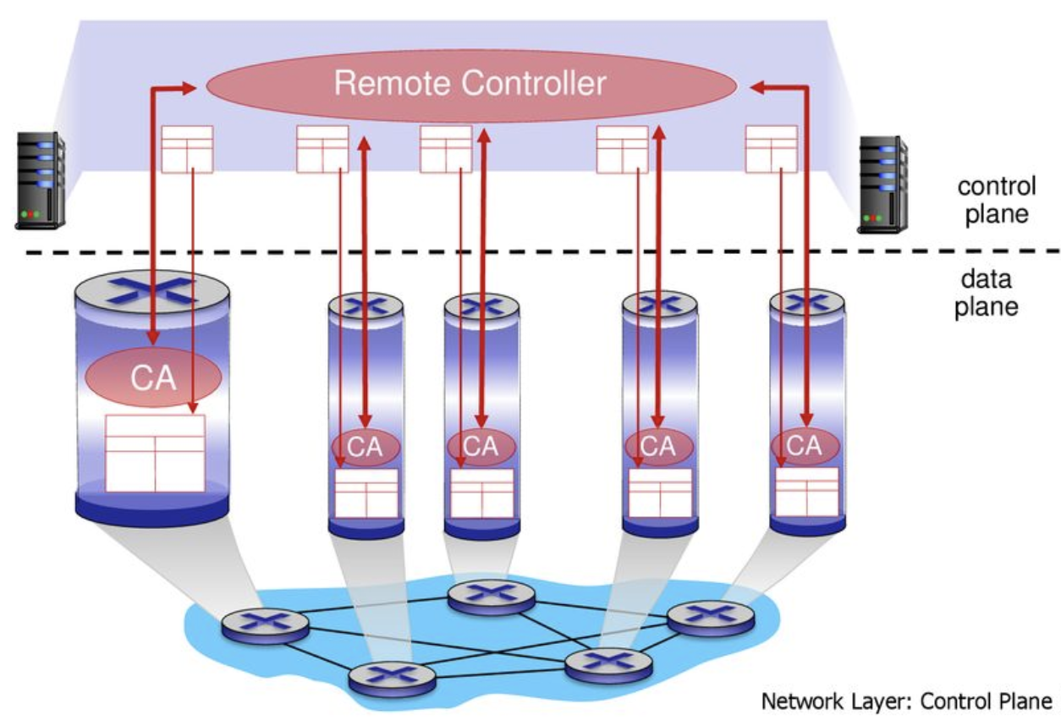
SDN-enabled Switches
A centralized controller is introduced – software-defined networking (SDN)

Slide 5
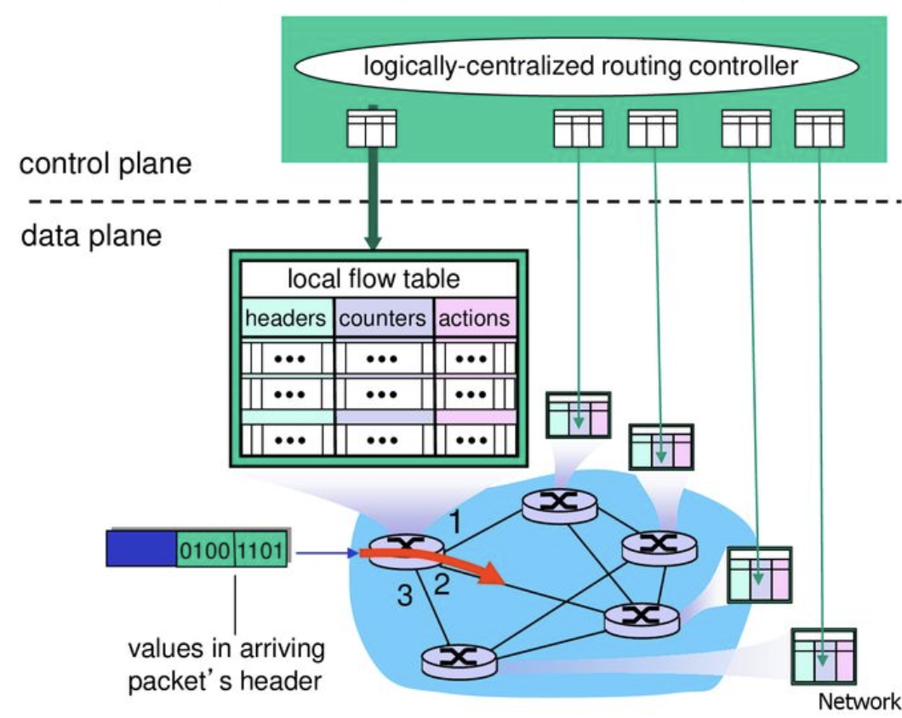
Installing Rules in the SDN-enabled Switches

Slide 6
Routing Information
Input: a graph with link weights and destinations
Output: shortest paths towards all destinations
(Tie breaking) If two next nodes have the same hop, then choose the one with a smaller ID
Then, store the information in each node’s table
1
1
3
3
1
1
1
1
0
2
4
1
3

Slide 7
Routing Paths (Trees)
1
1
3
3
1
1
1
1
0
2
4
1
3
Input: a graph with link weights and destinations
Output: shortest paths towards all destinations
Shortest path trees (SPTs)
1
3
0
2
4
1
3
0
2
4

Slide 8
Routing Table
1
1
3
3
1
1
1
1
0
2
4
1
3
Key: each destination
Value: the next node (i.e., the output port)
Node 0’s table
Destination | Next Node
1 | 1
4 | 1
1
3
0
2
4
1
3
0
2
4

Slide 9
Routing Path Update (aka Network Update)
Input: the same graph with new link weights
Output: the new next node (i.e., the output port)
1
1
1
3
1
3
3
1
1
1
3
3
1
1
3
1
0
2
4
0
2
4
1
3
3
1
1
3
1
3
0
2
4
0
2
4

Slide 10
Routing Path Update (aka Network Update)
Input: the same graph with new link weights
Output: the new next node (i.e., the output port)
1
1
1
3
1
3
3
1
1
1
3
3
1
1
3
1
0
2
4
0
2
4
1
3
3
1
1
3
1
3
0
2
4
0
2
4

Slide 11
Routing Path Update (aka Network Update)
For each destination, a new tree is generated
The information in the table should be updated
1
3
1
3
0
2
4
0
2
4
Node ID
0 | 1 | 2 | 3 | 4
1 | 3 | 3 | 4 | -1
Node ID
0 | 1 | 2 | 3 | 4
3 | 3 | 4 | 2 | -1
To 4
To 4

Slide 12
Note
Create switches with class SDN_switch
Each switch has an unsigned int ID
node::node_generator::generate("SDN_switch",id);
Every node only knows its neighbors
Add the neighbors for each switch
node::id_to_node(0)->add_phy_neighbor(1);
node::id_to_node(1)->add_phy_neighbor(0);
We use simple_link with a fixed latency (i.e., 10)
Write a map<unsigned int, unsigned int> to store each entry in each switch’s table (i.e., <destination ID, next node ID>) in class SDN_switch
Copy and modify the routing table code in HW1
Notes:
在這個圖中，每個點每個點只有自己的 neighbor 資訊，且必須各自決定哪些 edge 應該要砍掉，哪些 edge 應該要留著
vector<node> 的 vector 裡面要求要存的東西是 node。實際上要存哪一種type都可以，它很好用

Slide 13
Note
Define the rules to handle the received packet in class SDN_swtich’s member function recv_handler
void SDN_switch::recv_handler (packet *p)
Don’t use node::id_to_node(id) in recv_handler
Get the current switch’s ID and its neighbor
Use getNodeID() in recv_handler
Use getPhyNeighbors().find(n_id) to check whether the node with n_id is a neighbor
Use const map<unsigned int,bool> &nblist =getPhyNeighbors() and for (map<unsigned int,bool>::const_iterator it = nblist.begin(); it != nblist.end(); it ++) to get all neighbors
Use send_handler(packet *p) to send the packet
Check the packet type
if (p->type() == "SDN_data_packet")
Notes:
在這個圖中，每個點每個點只有自己的 neighbor 資訊，且必須各自決定哪些 edge 應該要砍掉，哪些 edge 應該要留著
vector<node> 的 vector 裡面要求要存的東西是 node。實際上要存哪一種type都可以，它很好用

Slide 14
Note
Decode: Cast the packet to the right type
dynamic_cast<SDN_data_packet *> (p)
dynamic_cast<SDN_ctrl_packet *> (p)
…
Will be explained in the later chapters
Generate the data and control packets
void data_packet_event(unsigned int src, unsigned int dst, unsigned int t, string msg)
A packet will be sent from a source to a destination at time t
void ctrl_packet_event(unsigned int dst, unsigned int t, string msg)
A packet received by a switch at time t with the content msg
The control packet’s msg is used to update an entry in the switch’s routing table
A packet received by a switch at time t with the content msg
msg contains: "dstID nexID"
Notes:
在這個圖中，每個點每個點只有自己的 neighbor 資訊，且必須各自決定哪些 edge 應該要砍掉，哪些 edge 應該要留著
vector<node> 的 vector 裡面要求要存的東西是 node。實際上要存哪一種type都可以，它很好用

Slide 15
Programming Project #1: Routing Table
Input:
Numbers of nodes, destinations, and links
Destinations
Links with old weights
Links with new weights
Source-destination pairs with forward start time
Network update time (1st and 2nd are for installation and update, resp.)
Simulation duration
Procedure:
Compute old shortest paths to destinations
Compute new shortest paths to destinations
Forward the packet from the source to the destination at the forward start time
Install and update routing tables’ rules at the network update time
Output:
All packets transmitted in the network (automatically generated by the given code)

Slide 16
Input Sample: use cin
e.g.,
5 2 8
0 100 300
1
4
0 0 1 1 3
1 0 2 1 3
2 0 3 3 1
3 1 2 1 3
4 1 3 1 1
5 2 3 1 1
6 2 4 3 1
7 3 4 1 3
10 0 1
20 1 4
110 0 1
120 1 4
Format:
#Nodes #Dsts #Links
InsTime UpdTime SimDuration
DstID
…
LinkID Node1 Node2 oldW newW
…
Time SrcID DstID
…
1
1
1
3
1
3
3
1
1
1
3
3
1
1
3
1
0
2
4
0
2
4
1
3
3
1

Slide 17
Output Sample: use cout
It suffices to implement recv_handler and the other components
The output will be automatically generated ☺
Note that the output could be different in different computers

Slide 18
Note
Superb deadline: 3/29 Tue
Deadline: 4/5 Tue
Pass the test of our online judge platform
Submit your code to E-course2
Demonstrate your code remotely with TA
C++ Source code (only C++; compiled with g++)
Include C++ library only (i.e., no more stdio, no stdlib, …)
Show a good programming style

Slide 19
Discussion Difficulty of Network Update in SDN
The controller is logically-centralized
However, the underlying mechanism is distributed
Each switch receives the update message and updates its rule independently and asynchronously
loop
1
3
1
3
Destination
drop
0
2
4
0
2
4
Node ID
0 | 1 | 2 | 3 | 4
1 | 3 | 3 | 4 | -1
Node ID
0 | 1 | 2 | 3 | 4
1 | 3 | 3 | 2 | -1
To
To

Slide 20
Discussion Possible Solution to Blackholes and Loops
Round-based update
Old
Step 2: Update 3
1
3
1
3
0
2
4
0
2
4
Step 1: Update 0 and 2
New
1
3
1
3
0
2
4
0
2
4

Slide 21
The Next Project Will…
Implement more realistic links rather than simple links → class SDN_link
Each link could have different latency
Implement a new class SDN_controller
Create a SDN controller and SDN switches and then connect each switch to the controller
Implement the round-based update
A competition may happen:
Maybe: Less update rounds → Higher score

